Slide 1
Imagine the Possibilities
iPad Summit
CAIU
December 18, 2012
Notes:
Start with music playing
Beautiful Day -
ABC - With any and all technology integrations always go back to good solid instruction starting with the basics

Slide 2
Polling Apps
Open a web browser
Go to Pollev.com
Put in this code and answer the question
Notes:
Traci

Slide 3
QR Code
Zap the
Code
Go to our
iOS Site
Go to our Back Channel at Today’s Meet
http://todaysmeet.com/ipadsummitdtsd
Notes:
Traci
Hand out cards
Introduce back channel

Slide 4
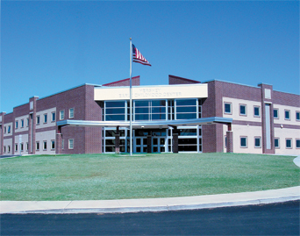
About Derry Township
Hershey, PA
3,600 students -1,500 in Elementary
5 Buildings on one campus
Went mobile in Elem in 2008-09
Classrooms in 2010-11
K-3 - 2 desktops & 2 netbooks
4-5 - 2 desktops & 4 netbooks
Notes:
Al - use of iPads and apps ever increasing in elementary and to some level, across district

Slide 5
Mission & Vision
Notes:
Joe
21st Century Teaching and Learning committee-began in late 2010 as a one-to-one committee
committee consists of teachers and administrators from all levels as well as a school board member. Additionally, feedback from parents and students has been solicited to help guide the work. Three sub-committees: PD, policy, communications
Use the HEAT framework as the frame for all PD and decision making.
Multi-year focus (no LYNT/TYNT)
changed focus and name from technology centered to teaching and learning centered
developed 21st century vision: to seize the potential of digital resources to transform teaching and learning to prepare students for success in the 21st Century

Slide 6
iPad Initiative Conception
Refresh cycle for
computers
Notes:
Al

Slide 7
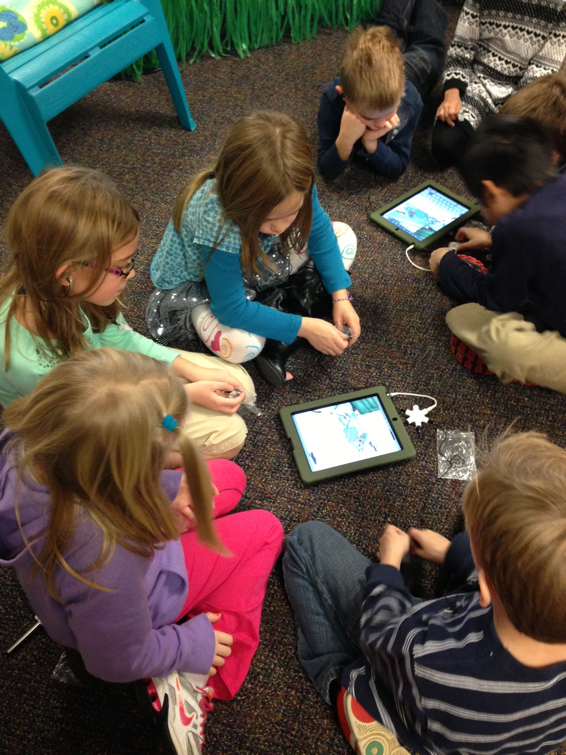
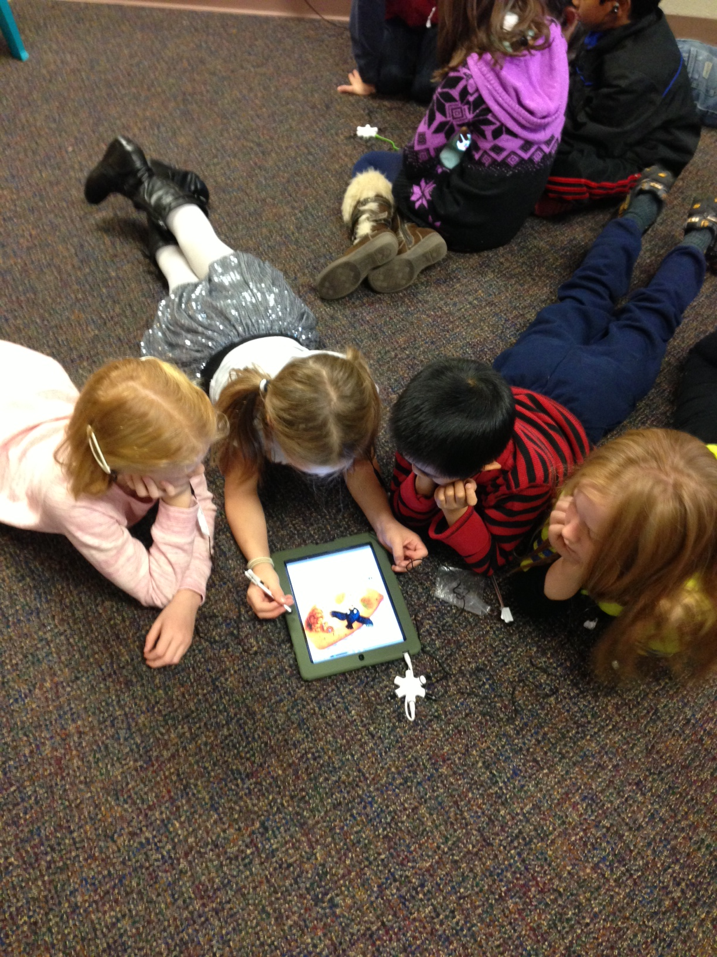
iPad Pilot
2 Teachers/grade level
Existing Curriculum
Teacher Input
Notes:
Traci & Joy
How can we do what we've always done
what works
what doesn't work
What does it do differently - iPads have the power to be transformational!!
Create content Transformational
Do some of the things we have always done and other things previously not possible
2 teachers/grade level
One tech savvy on low tech
Devices 1 ipad & 2 ipod touches
½ day PD
Pilot teachers reported back to the grade levels
Given a structure of choices each grade level was ability to choose what to replace classroom devices and grade level carts with
Overwhelmingly grade levels chose to replace existing netbooks with ipads.

Slide 8
Professional Development
Commitment
It’s all about Instruction!
Notes:
Joe & Joy
Commitment = Technology acquisition must be tied to Professional Development
otherwise money spent on tech is useless
It's all about Instruction and enhancing it through use of technology
Small group meetings - Power meeting
Goal Setting - Joy

Slide 9
Professional Development
21st Century Learners and Learning
HEAT Framework
Notes:
Joe & joy
Link to framework and website

Slide 10
Inservice Days
Begin with H.E.A.T
Build Capacity
Keynote & Breakout Sessions
Debriefing
Notes:
Traci & Joy
Begin with H.E.A.T
Build Capacity
Allow teachers to take devices home – Use the device in their personal/professional life see transfer into the classroom
Allow individual customization
Debriefing at grade level and move ideas forward – Ongoing collaboration
power meetings
Just in time learning
Instructional Technology Coach

Slide 11
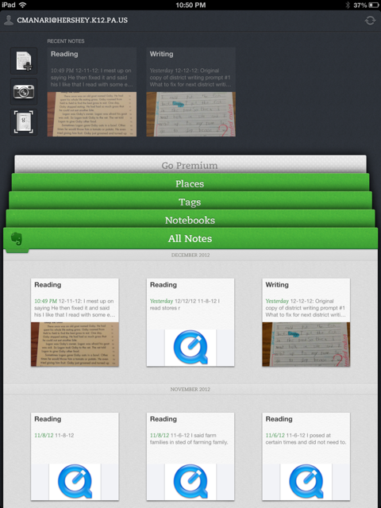
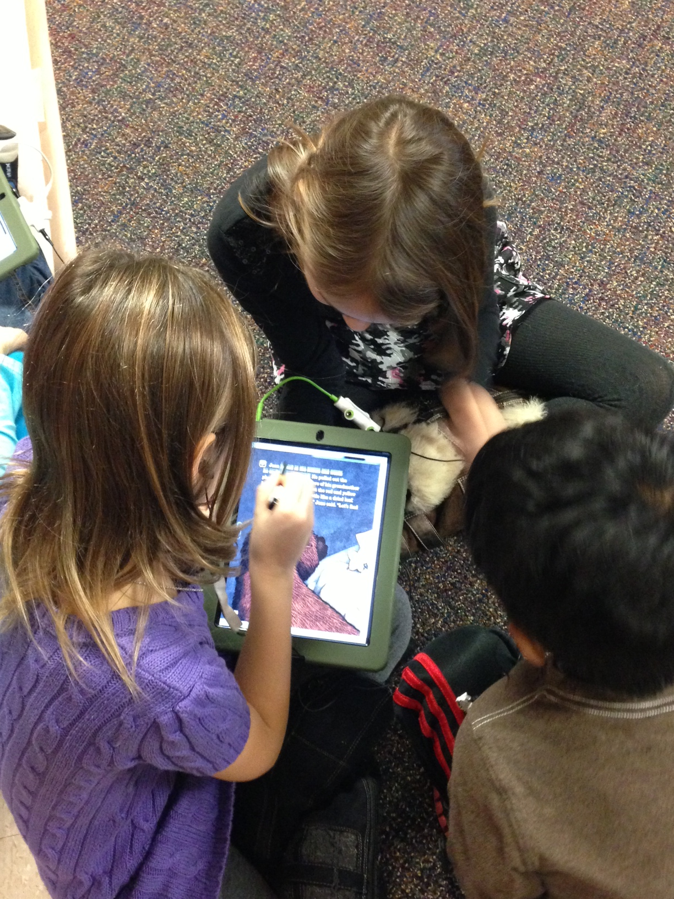
Teacher/Classroom Perspective
Impact on Teaching
and Learning
Implementation Rates This Year
Notes:
Tara & Christen

Slide 12
Kick-off Day - August Pilot Teachers Showcase of Possibilities
Classroom Implementation Webpage
K - Review and Reinforcement Apps
1- iMovie Trailer, Blogs, ScreenChomp, Evernote
1 - AudioBoo and QRcodes
2 - iMovie, ShowMe
Notes:
Traci

Slide 13
Teacher Showcase of Possibilities
3rd - Spelling City, Study Island, Reading Street
4th - Newbies, ShowMe - iPad in Room 50
5th - Google Docs for Word Processing
Notes:
Traci

Slide 14
Management
Institutionalize a Personal Device
iTunes accounts
Volume Purchasing - Budget for apps
Notes:
Traci, Al, Alex
Personal device making it institutional
Lessons learned – had to back up and regroup
Itunes accounts – Set up
Volume purchasing
20 or more apps ½ price for participating apps
Must buy the app for each device – not the same as personal use

Slide 15
Image Walk
Through
Notes:
Traci & Alex
Much planning and organization to the image
Mostly free apps But lots to choose from
There’s an app for that - How do you choose
organized by folders
Training around
Including links to existing curriculm content when there are no apps
Flash Issue – Rover but continues to be an issue.
Plans going forward
Separate image for each grade level/dept
Ability to push updates and apps out

Slide 16
Peripherals
Cases
Dongle
Notes:
Alex/Traci
Cases for durability
For all Devices
not seeing a ton of damage so far
Dongle for instructional purposes

Slide 17
Management
Meraki
Apple Configurator
Settings & Security
Notes:
Alex
Plan for management
Plans going forward

Slide 18
Existing Curriculum – Reading Street
Online Assessments
eText App
Grammar Jammers
Notes:
Traci If needed

Slide 19
Accessing Existing
Content
Notes:
Traci If needed

